Slide 1
[0:00–0:05] ESTABLISHING SHOT
Hide UI
Grainy VHS-style with camera overlay. focused and unfocused shot of the room with guy on table. Here's how it should look like
Patient seated -> change pose to a patient facing down (?)

Slide 2

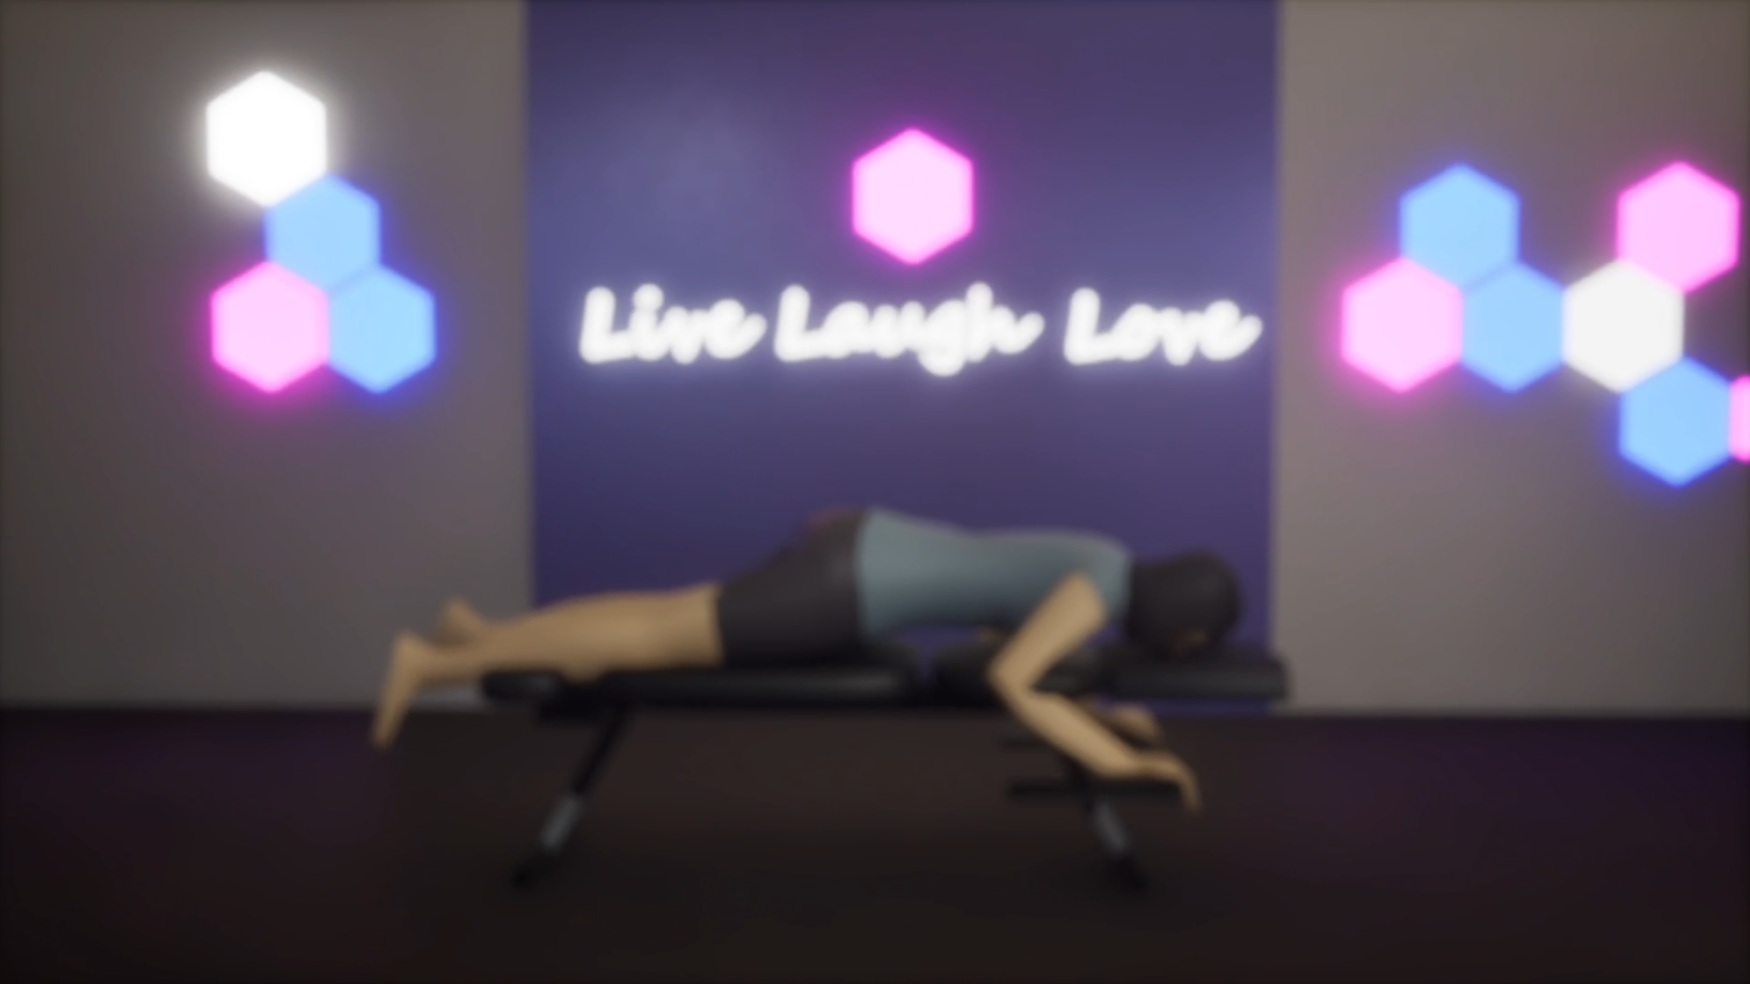
This is my clinic by the way, guys.

Slide 3
[0:06–0:10] THROWBACK/RISE TO FAME
Hide UI
old place relying on sunlight for lighting. 3 tables room
Live viewer counter in the environment shows "0 views" inspo

Slide 4
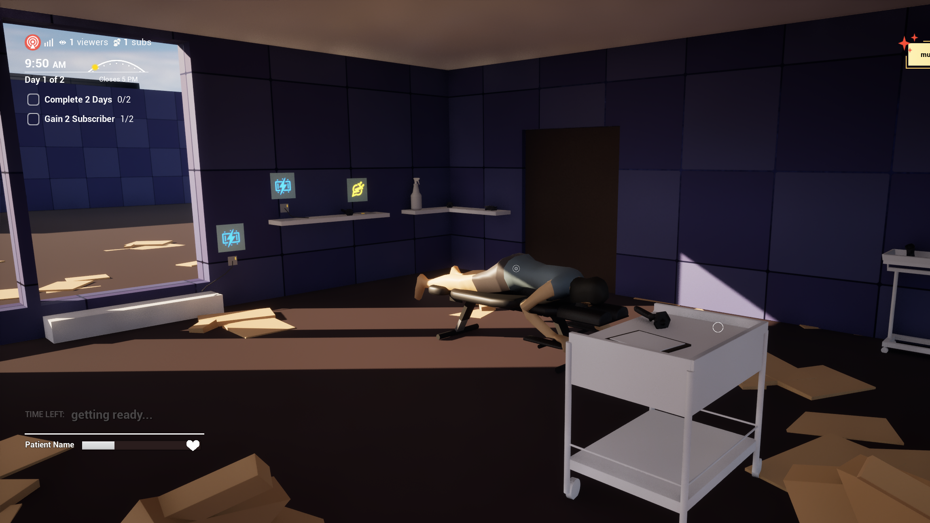
0 views
1s. Camera has slight movement (like this). No hands.
Started from the bottom

Slide 5
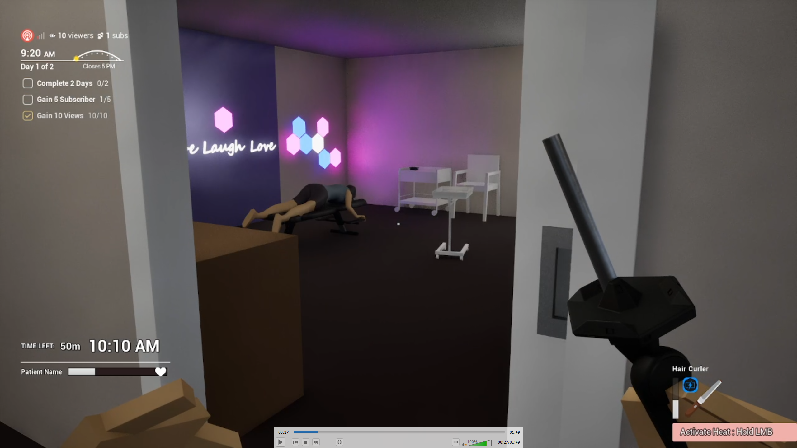
7K views
1s. Open door reveals this neon room. No hands.
2025-05-17 18-39-42.mp4
0:27–0:27
NOW WE’RE HERE

Slide 6
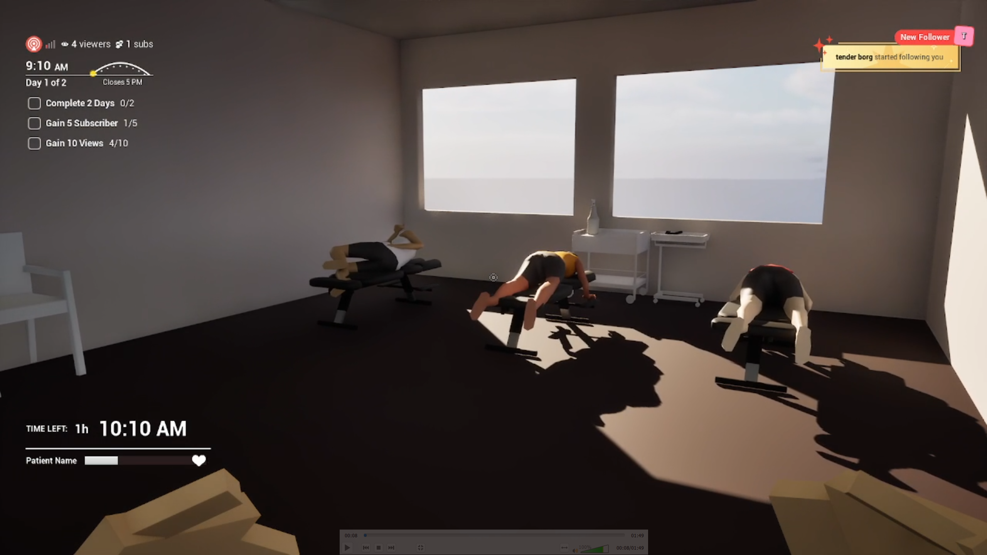
90K views
1s. Big room. Slow zoom. No hands.
2025-05-17 18-39-42.mp4
0:07 – 0:08
NOW WE’RE HERE

Slide 7
[0:11–0:30] GAMEPLAY SHOWCASE
body twist and limbs flailing. camera overlay & Fake views climbing ("28K", "90K", "LIVE: 666 viewers")
SFX: crack, patient reaction

Slide 8
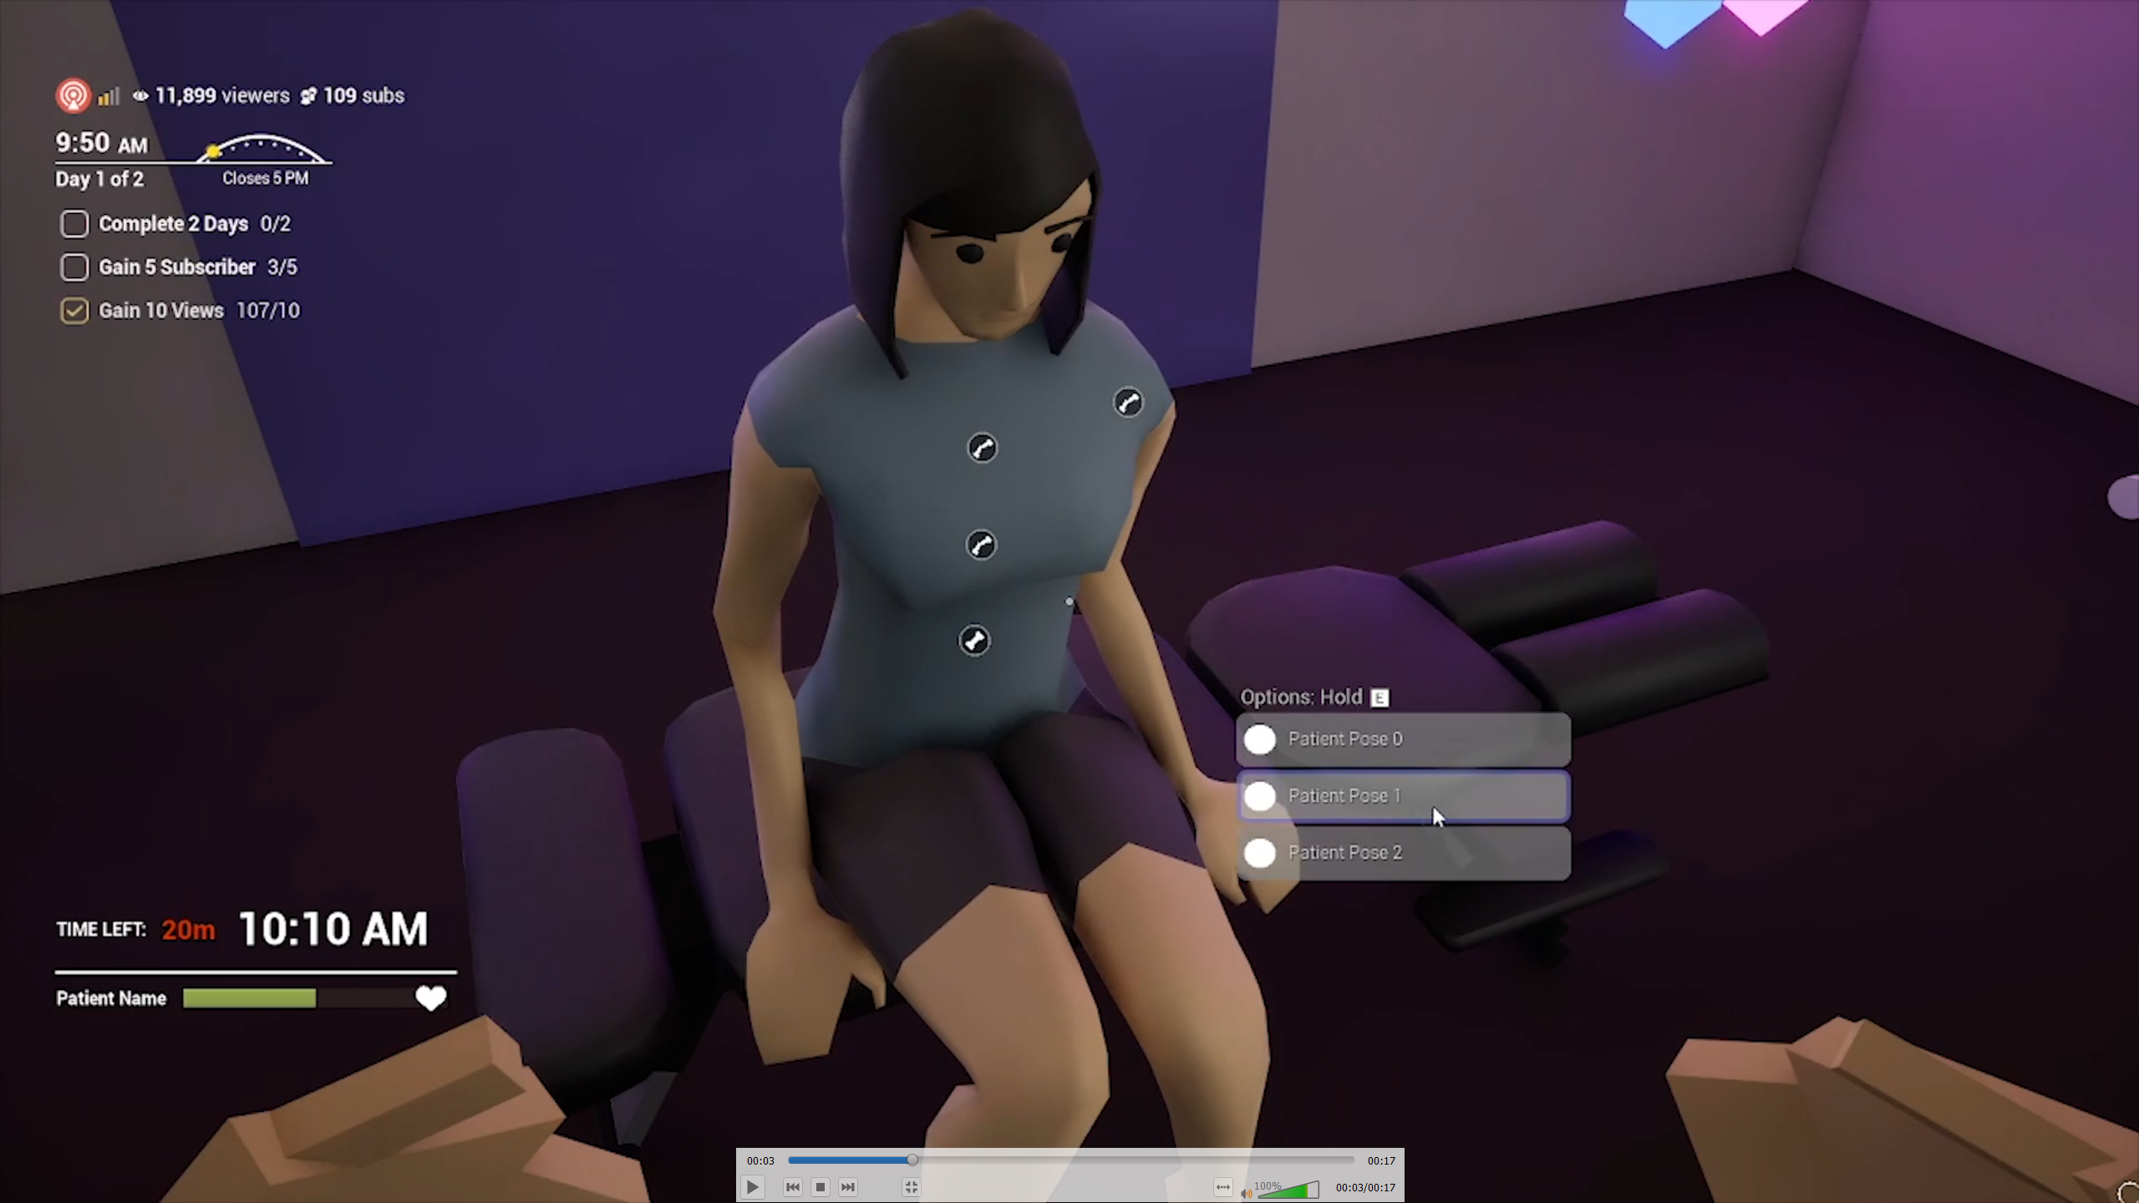
1s. Change patient pose
Uncertified_v0.5.mp4
0:03 – 0:04
Every moment is a content opportunity.

Slide 9
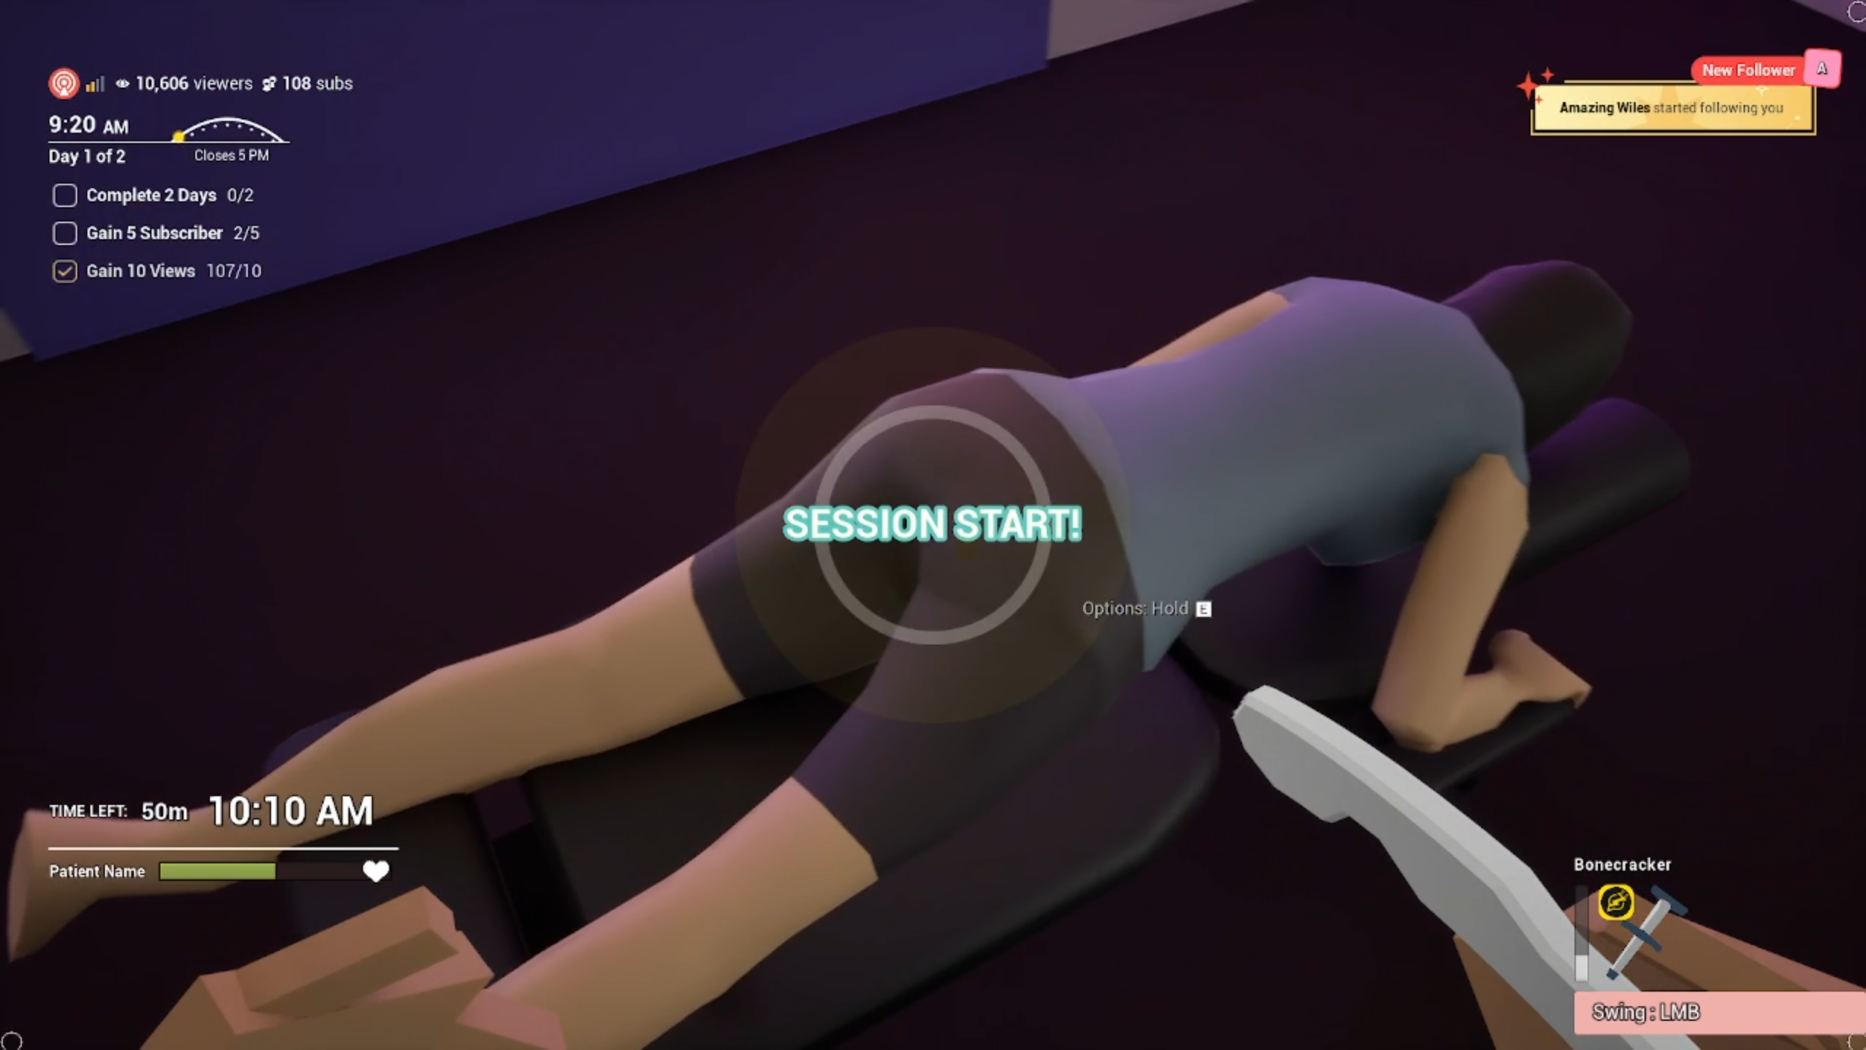
2s. Recreate “session start!” text w/ anim
2025-05-17 18-50-38.mp4
0:19 – 0:21
Every moment is a content opportunity.

Slide 10
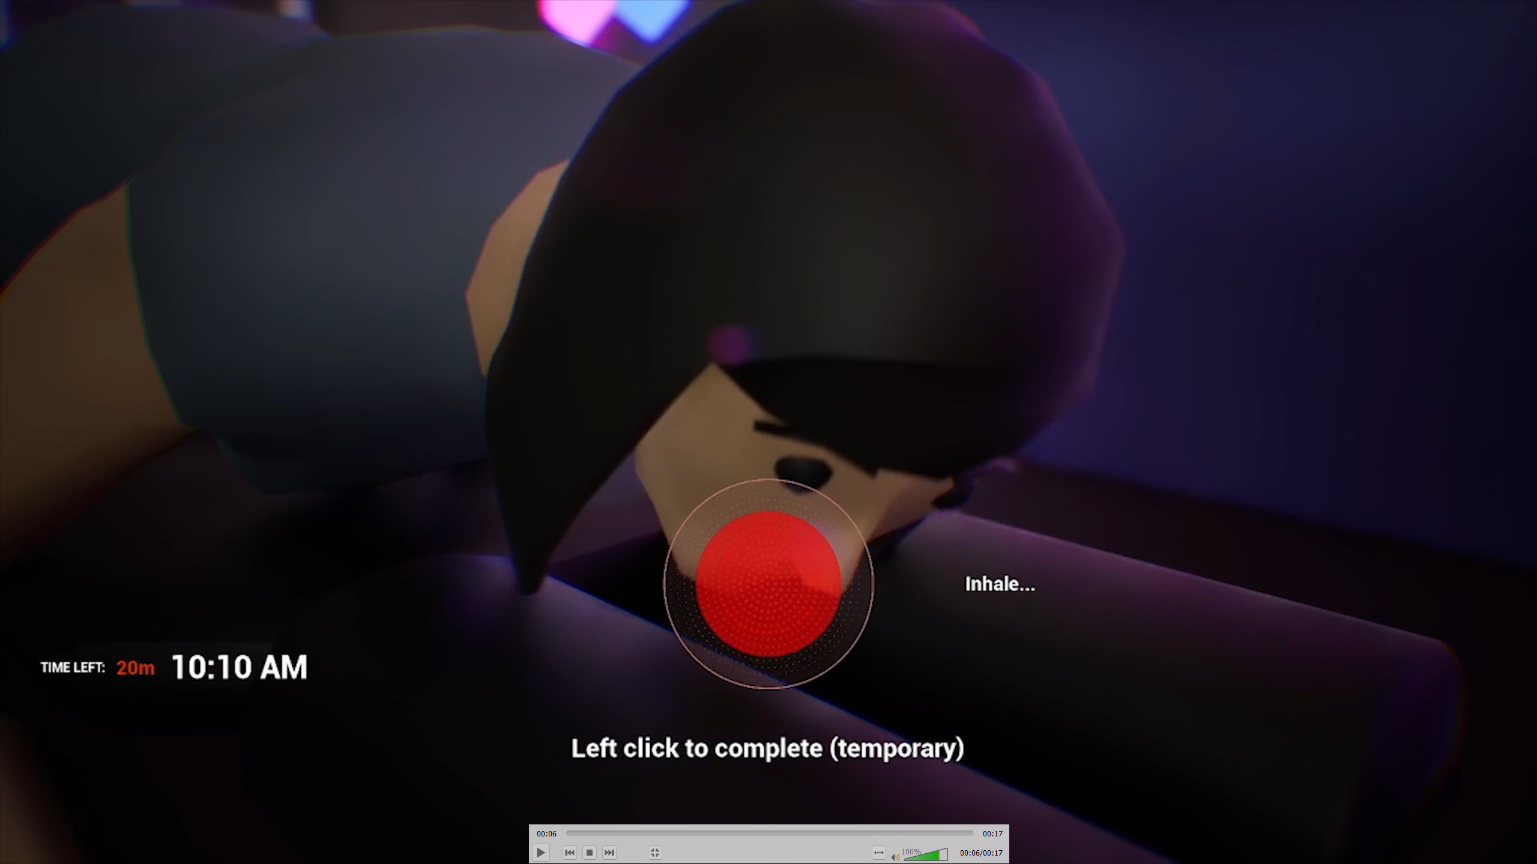
1s. minigame
Uncertified_v0.5.mp4
0:06 – 0:15
FOR THE ALGORITHM!!

Slide 11
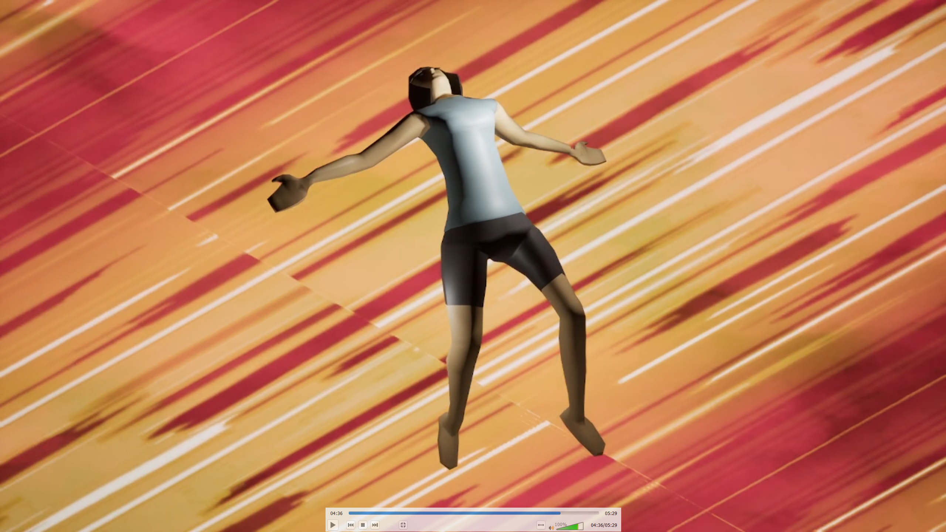
6s. Continue from this scene to show emojis
2025-05-17 18-50-38.mp4
04:36 – 04:42

Slide 12
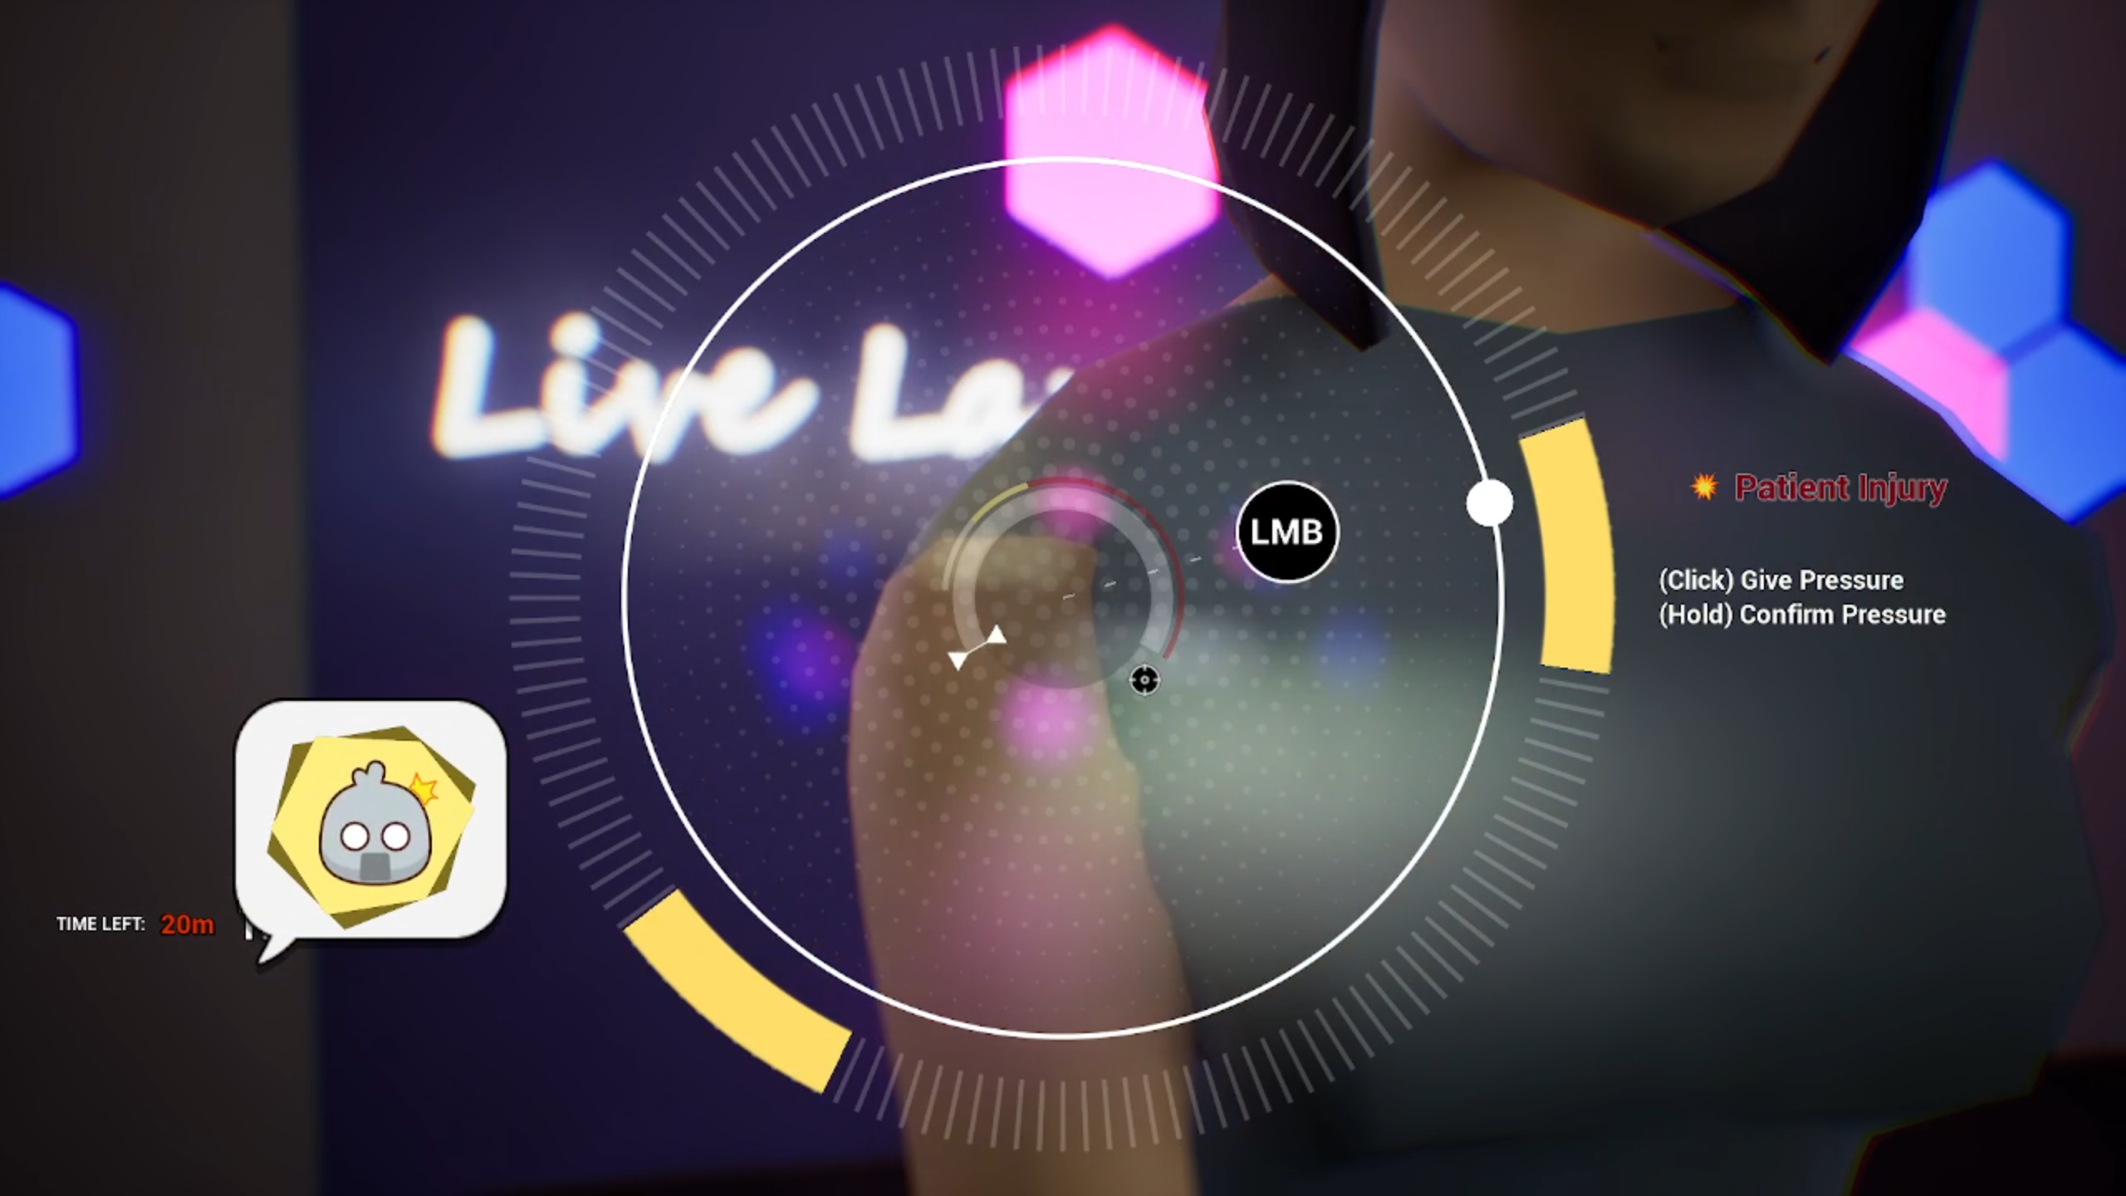
6s. Last shot is this
2025-05-17 18-50-38.mp4
04:36 – 04:42

Slide 13
[0:32–0:34] camera fall
Hide UI
“Wait, is this thing oh sh—”
(BLEEP + camera hits floor)

Slide 14
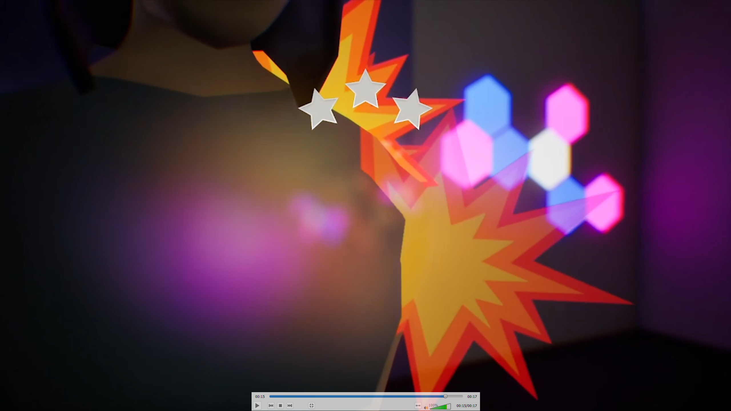
1s. This scene & zoom out. No stars.
Uncertified_v0.5.mp4
0:15 – 0:15
That’s a 90K-view—
(CRASH + bleep)

Slide 15
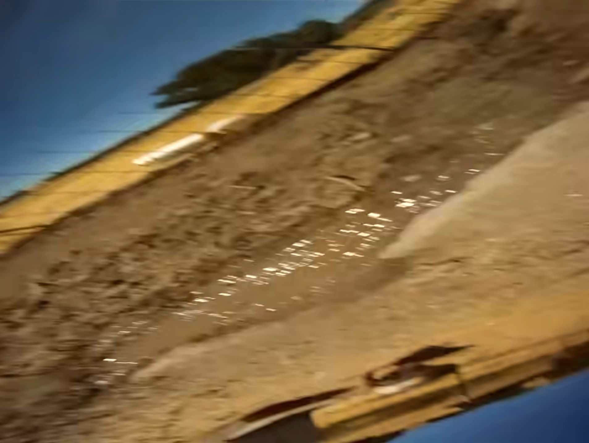
That’s a 90K-view—
(CRASH + bleep)

Slide 16
[0:35–0:38] Filler
“Wait, is this thing oh sh—”
(BLEEP + camera hits floor)

Slide 17
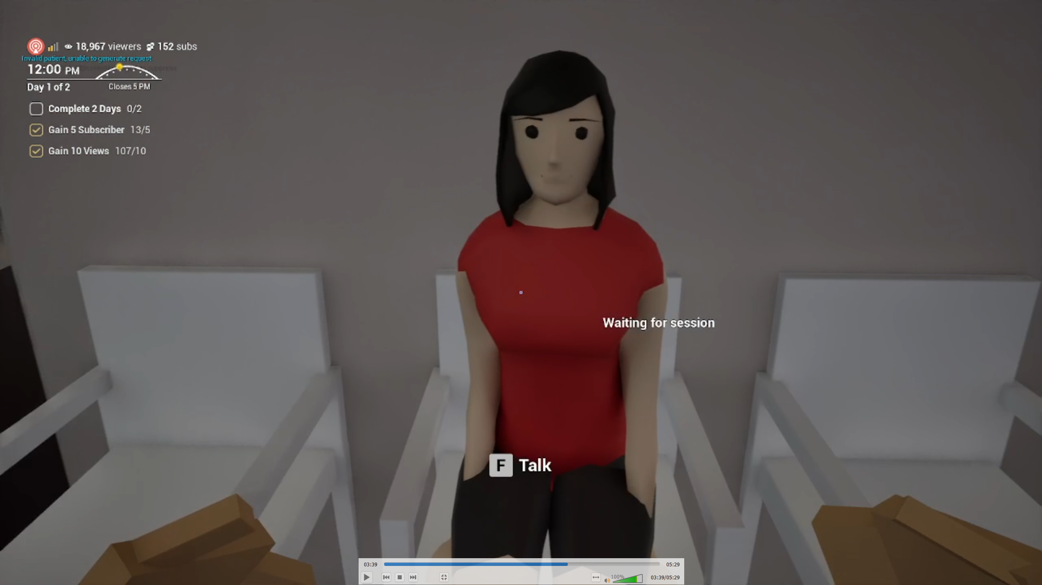
3s. Register patient
2025-05-17 18-50-38.mp4
03:39 – 03:41
Alright, you’re next.

Slide 18
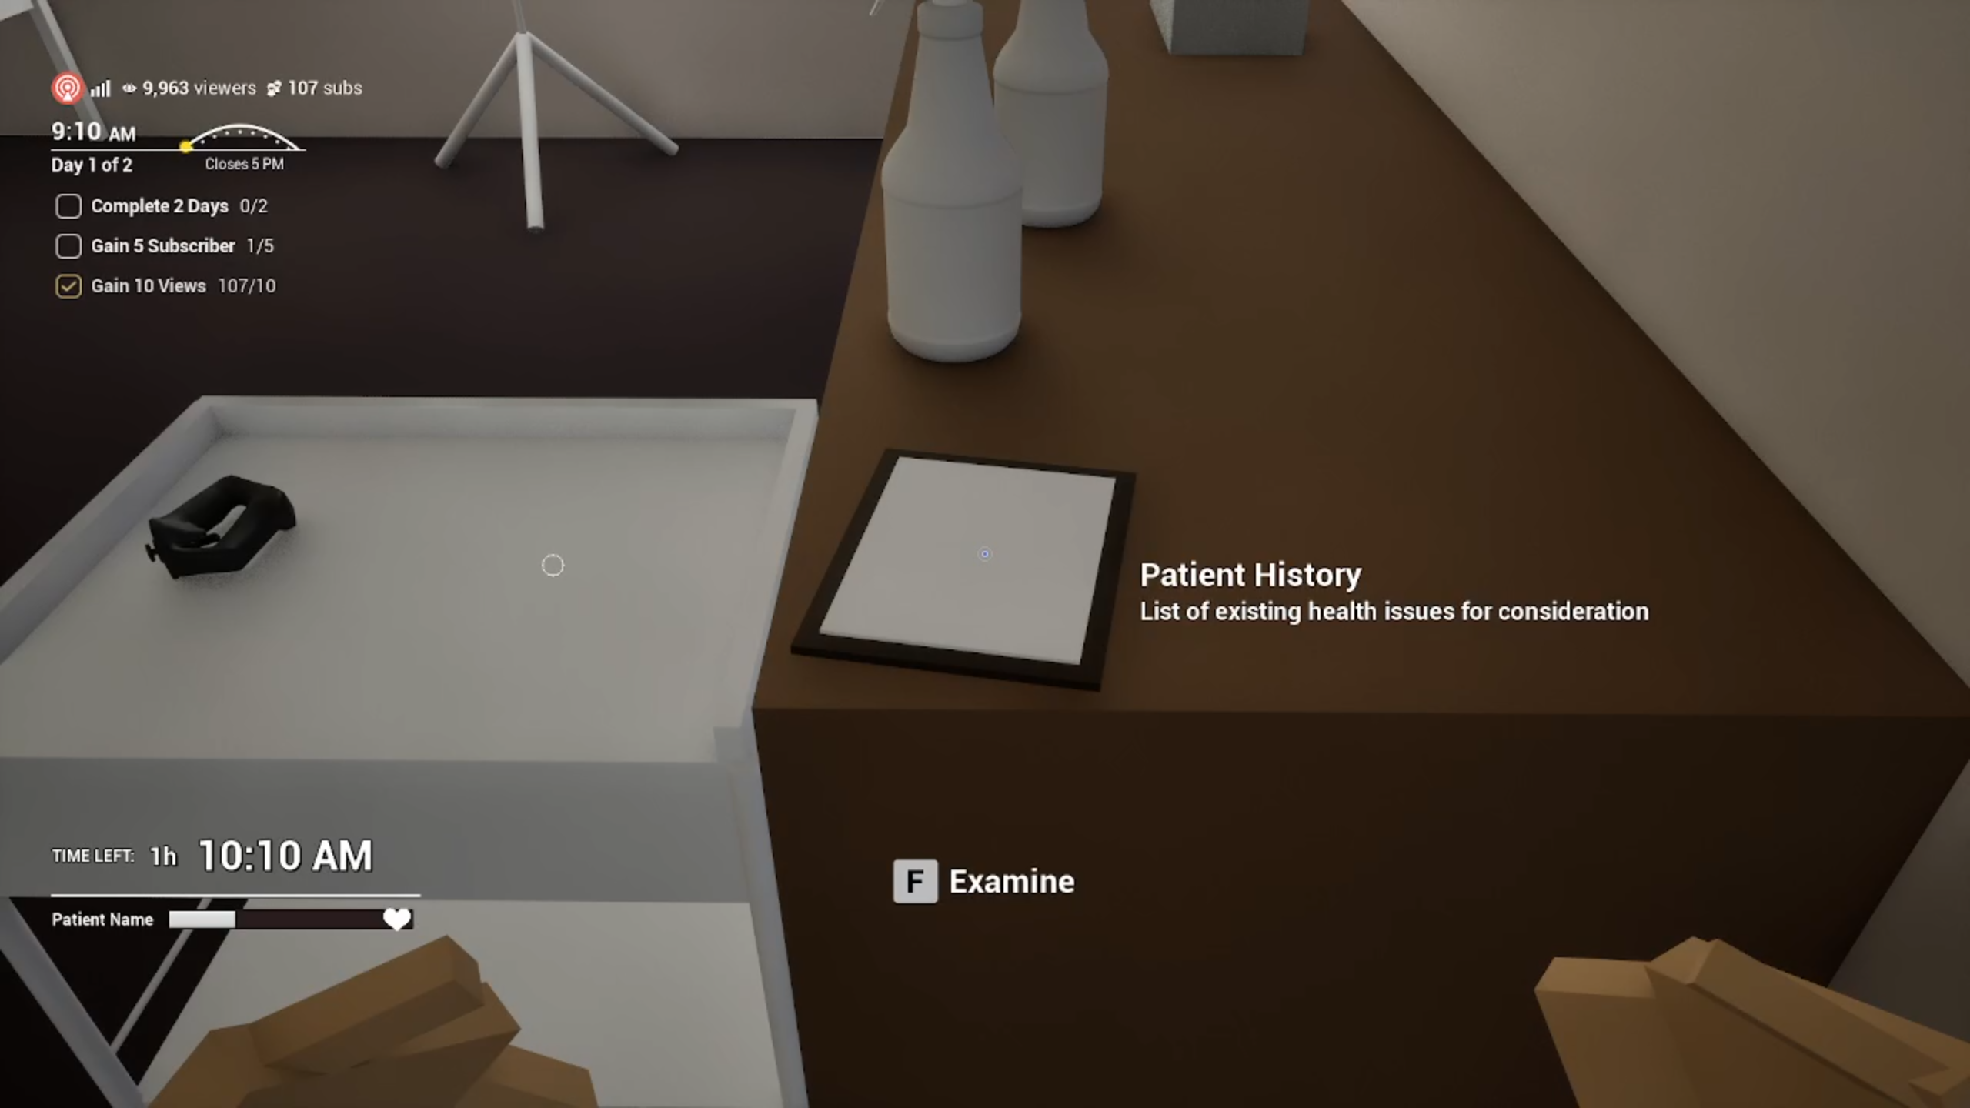
2s. View patient history. Remove checkbox
2025-05-17 18-56-39.mp4
00:08 – 00:12

Slide 19
[0:39–0:46] ABSURDITY ESCALATION
Hide UI (?)
Using different tools & clean table.
“Expensive tools are for noobs. Pros like me use… whatever.”

Slide 20
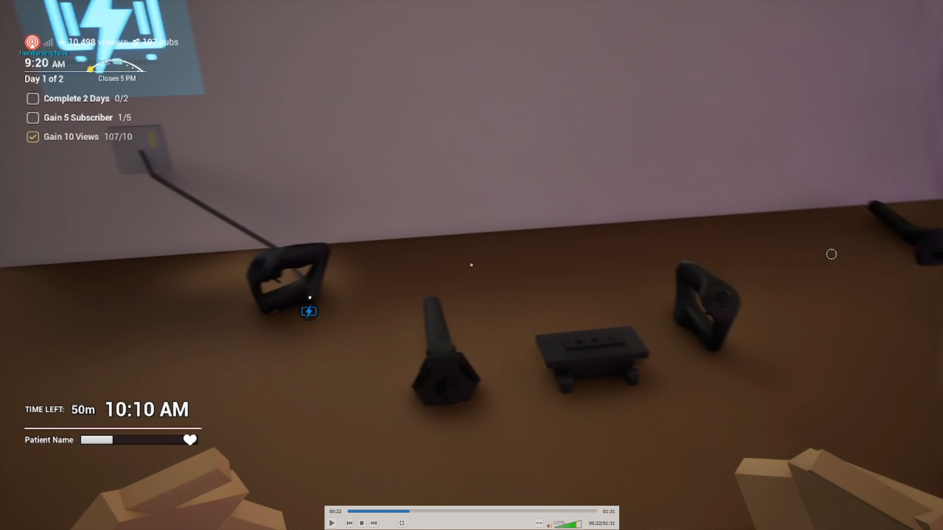
3s. Charge low battery and picks up massage gun
2025-05-17 18-59-36.mp4
0:21 – 0:24
Modern problems require… just vibes.

Slide 21
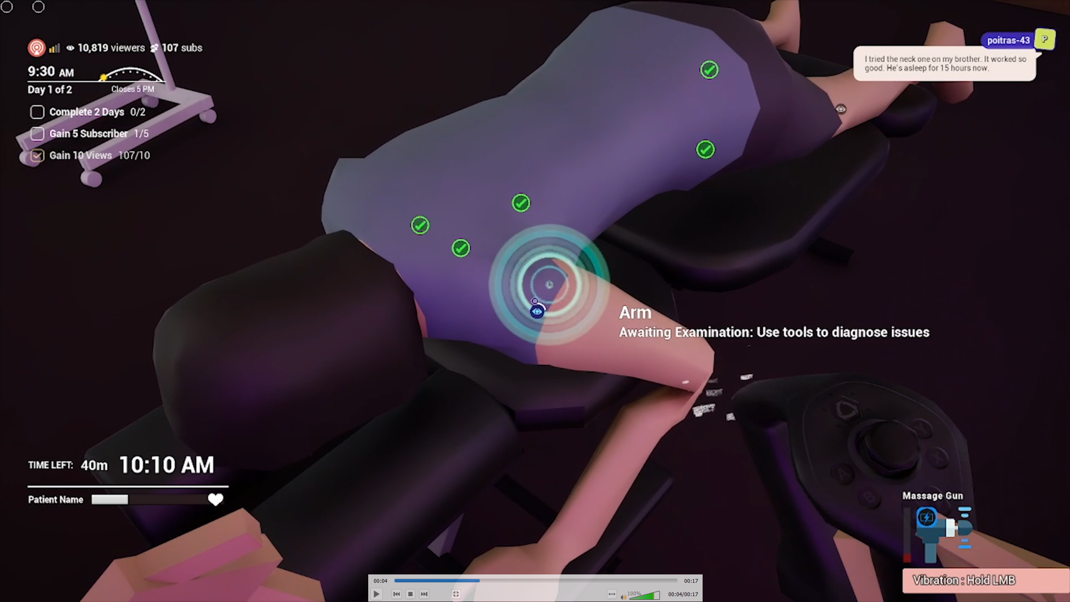
1.5s. Use massage gun
Uncertified_v0.5.mp4
0:04 – 0:04
Modern problems require… just vibes.

Slide 22
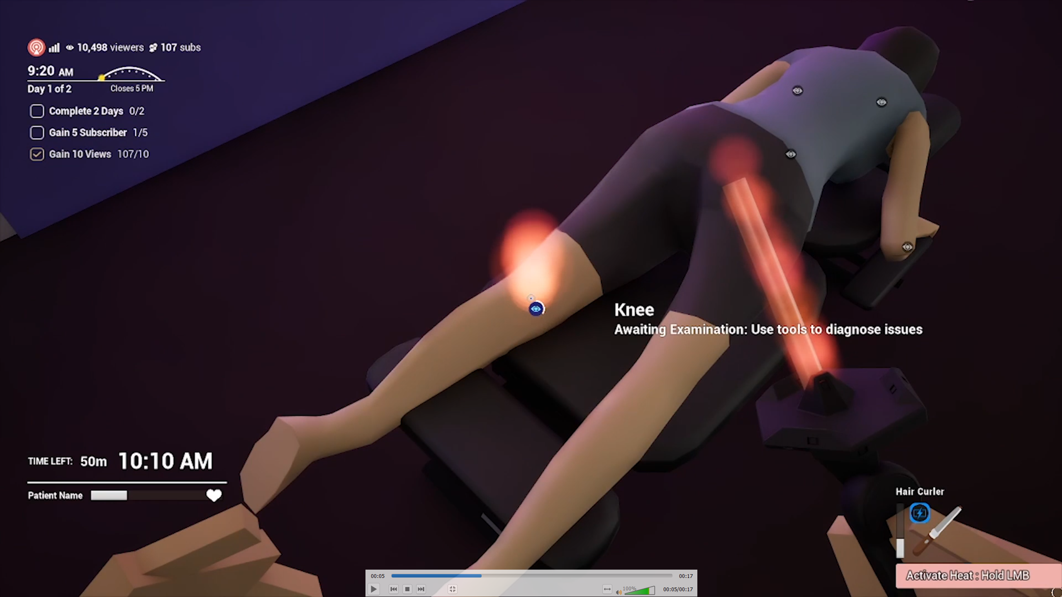
1.5s. Use rod at ass
Uncertified_v0.5.mp4
0:05 – 0:05

Slide 23
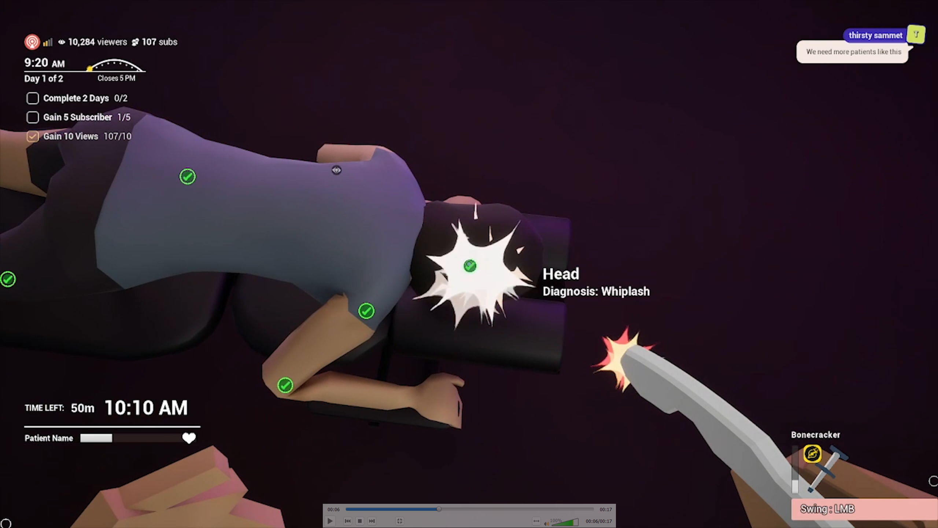
1.5s. Use bonecracker
Uncertified_v0.5.mp4
0:06 – 0:06 OR 2025-05-17 22-40-42.mp4
1:27–1:28

Slide 24
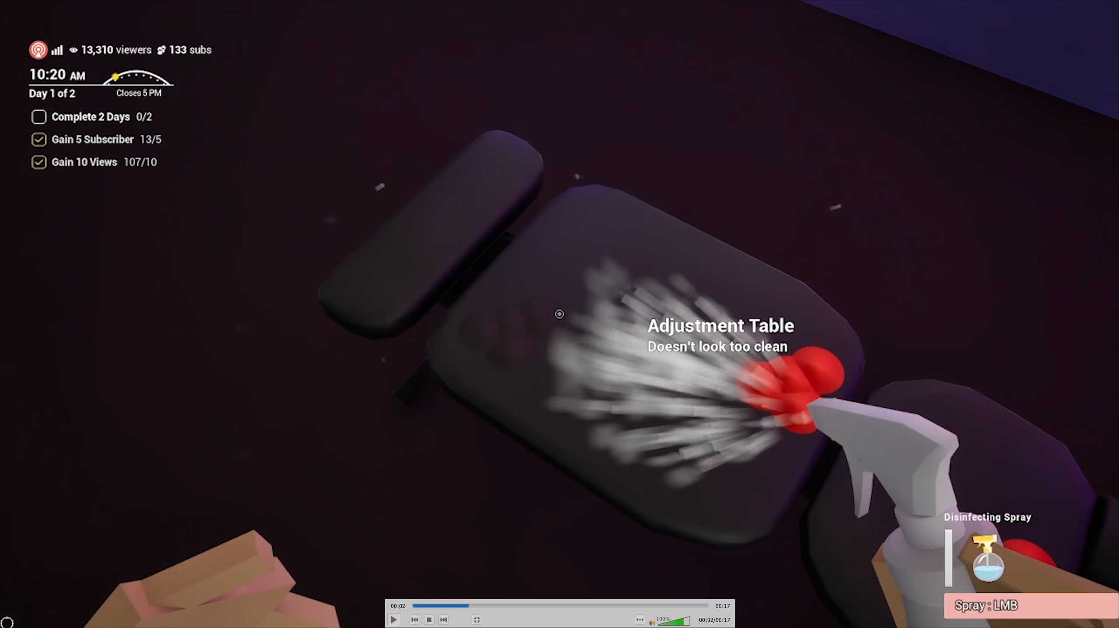
1.5s. Spray table
Uncertified_v0.5.mp4
0:02–0:02 OR 2025-05-17 18-46-57.mp4
1:49–1:51

Slide 25
[0:52–0:54] FINAL SHOT
Review screen + Fake UI stamp effect "TRY HARDER" appears (?)

Slide 26
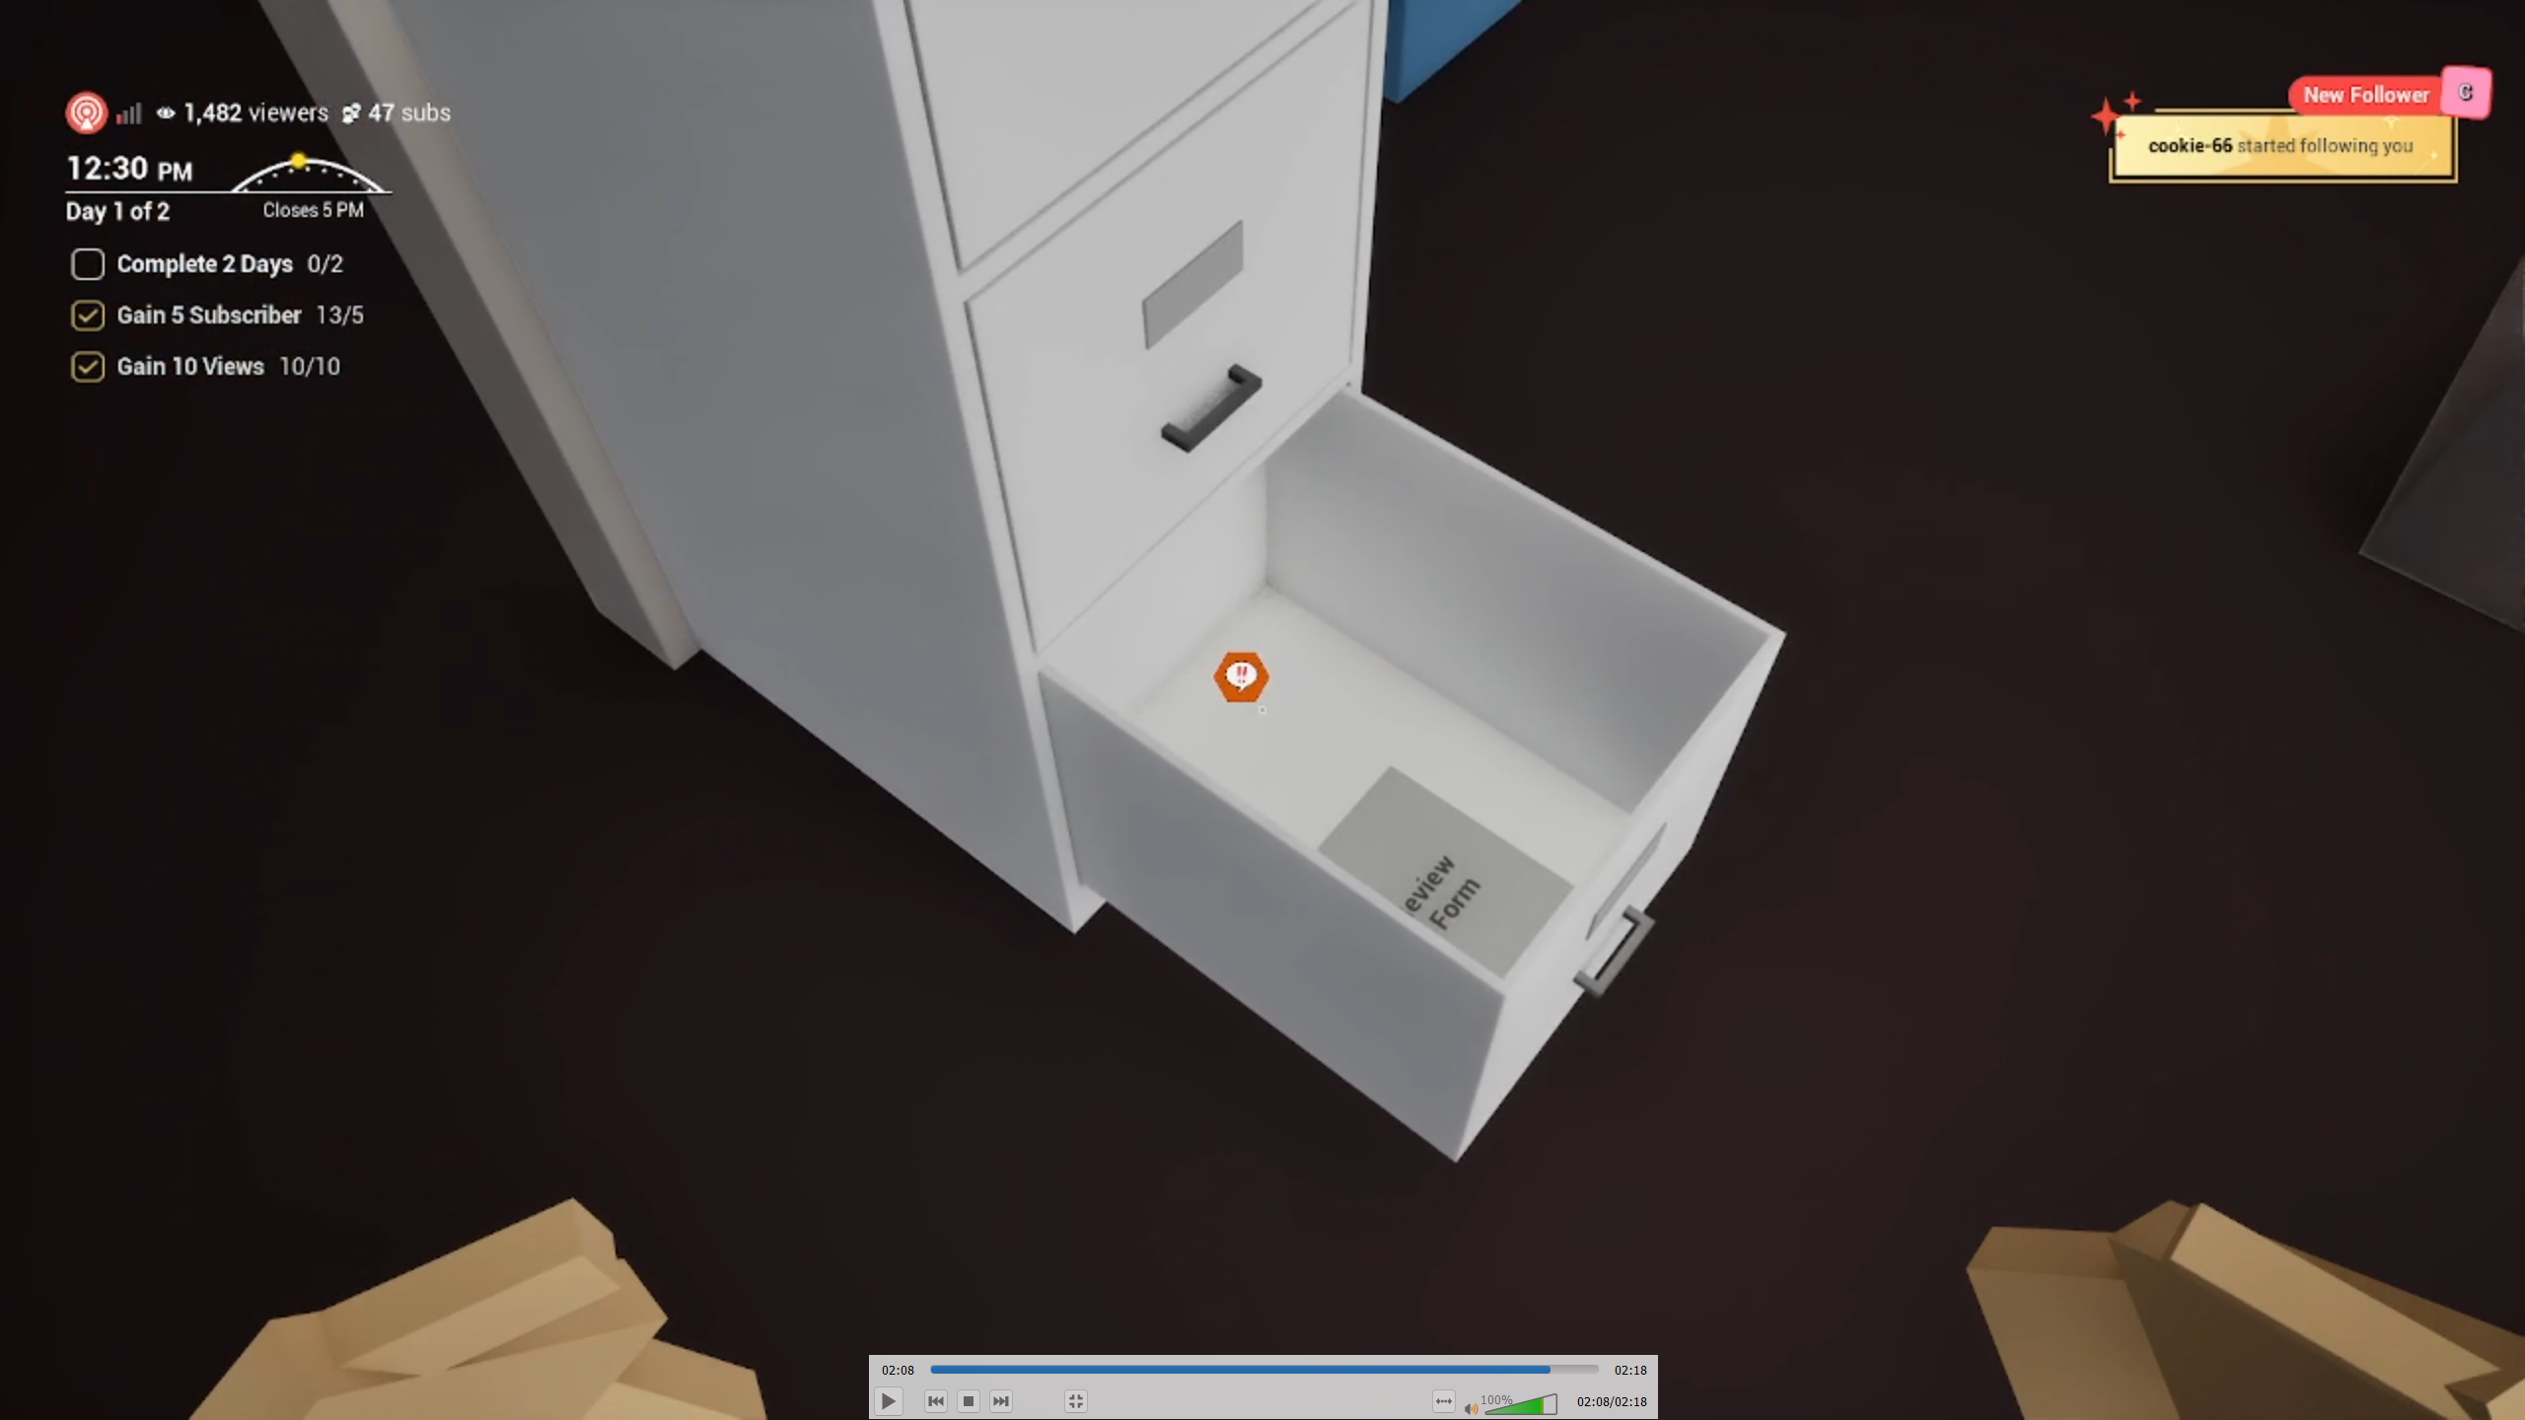
2s. Open drawer
2025-05-17 18-42-06.mp4
2:08 – 2:10

Slide 27
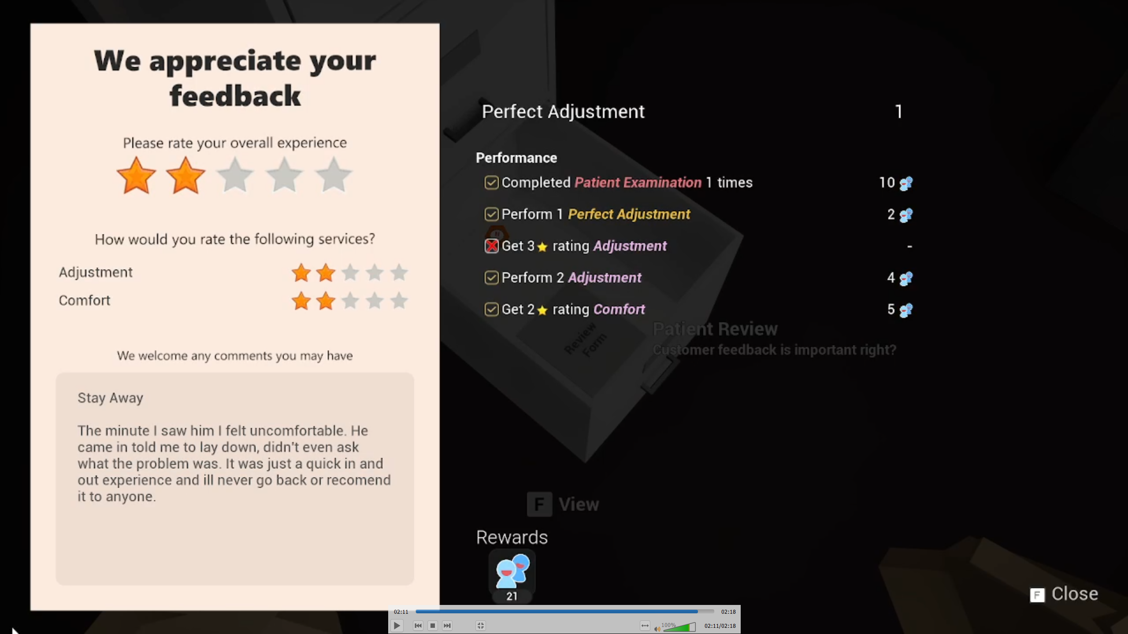
2s. Read review
2025-05-17 18-42-06.mp4
2:11– 2:11
(unintelligible muttering)
Two star. Seriously?!

Slide 28
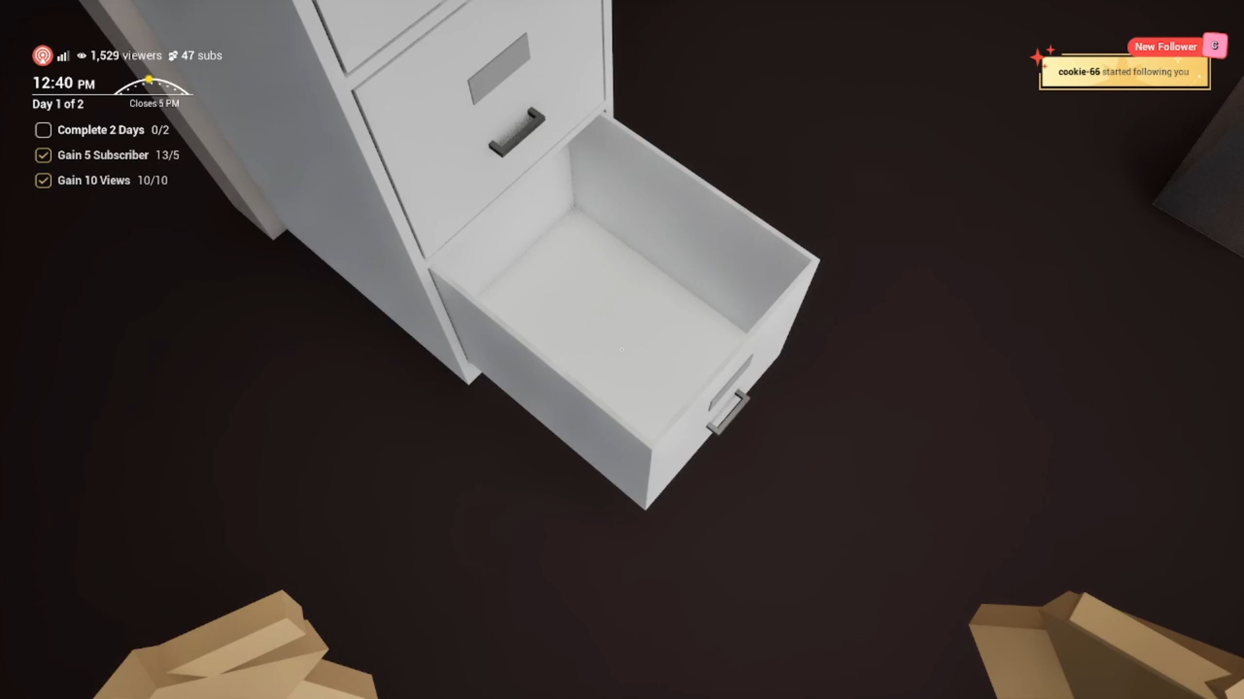
2s. Play notification ding sound. Open drawer above 2025-05-17 18-42-06.mp4
2:14 – 2:15
Another just came in.

Slide 29
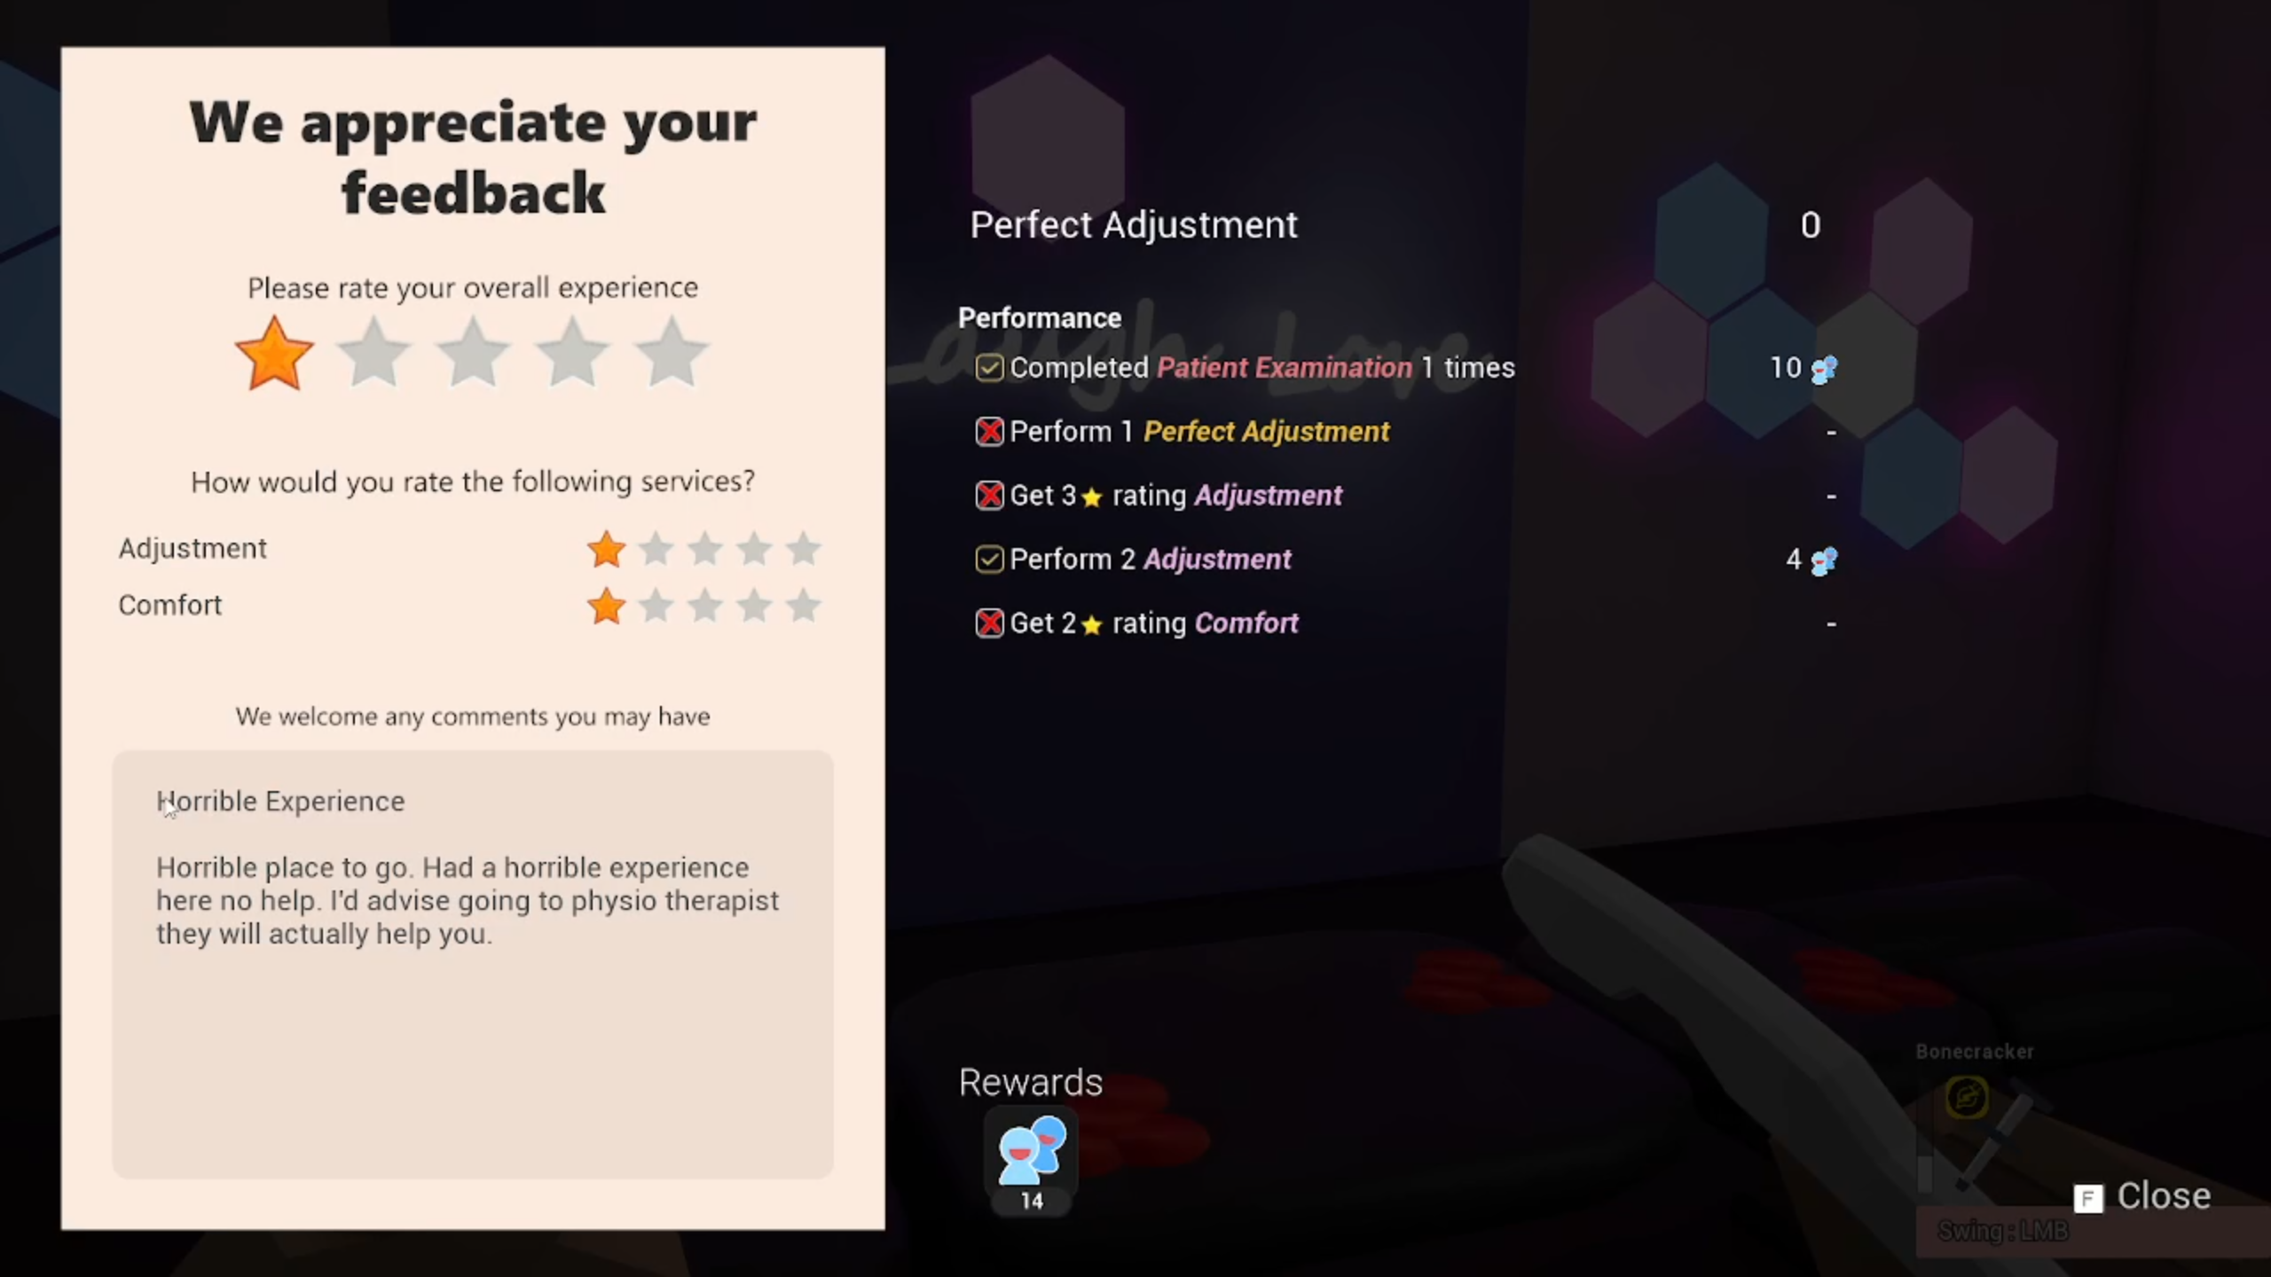
2s. Read 1-star review
2025-05-17 18-50-38.mp4
03:24 – 03:27
They must be spies from that clinic beside me.

Slide 30
[0:55–0:60] CALL TO ACTION
(on black) game Logo -> coming soon (all caps maybe)

Slide 31


Slide 32
COMING SOON

Slide 33

18s “portfolio” video. #FCF4FC Timer bar (15px height) and scrolling url

Slide 34
[1:01–1:20] IN-ENGINE SHOT
fade in from black, "in-engine proof" text overlay 3s in the center. Follow how the video did it

Slide 35
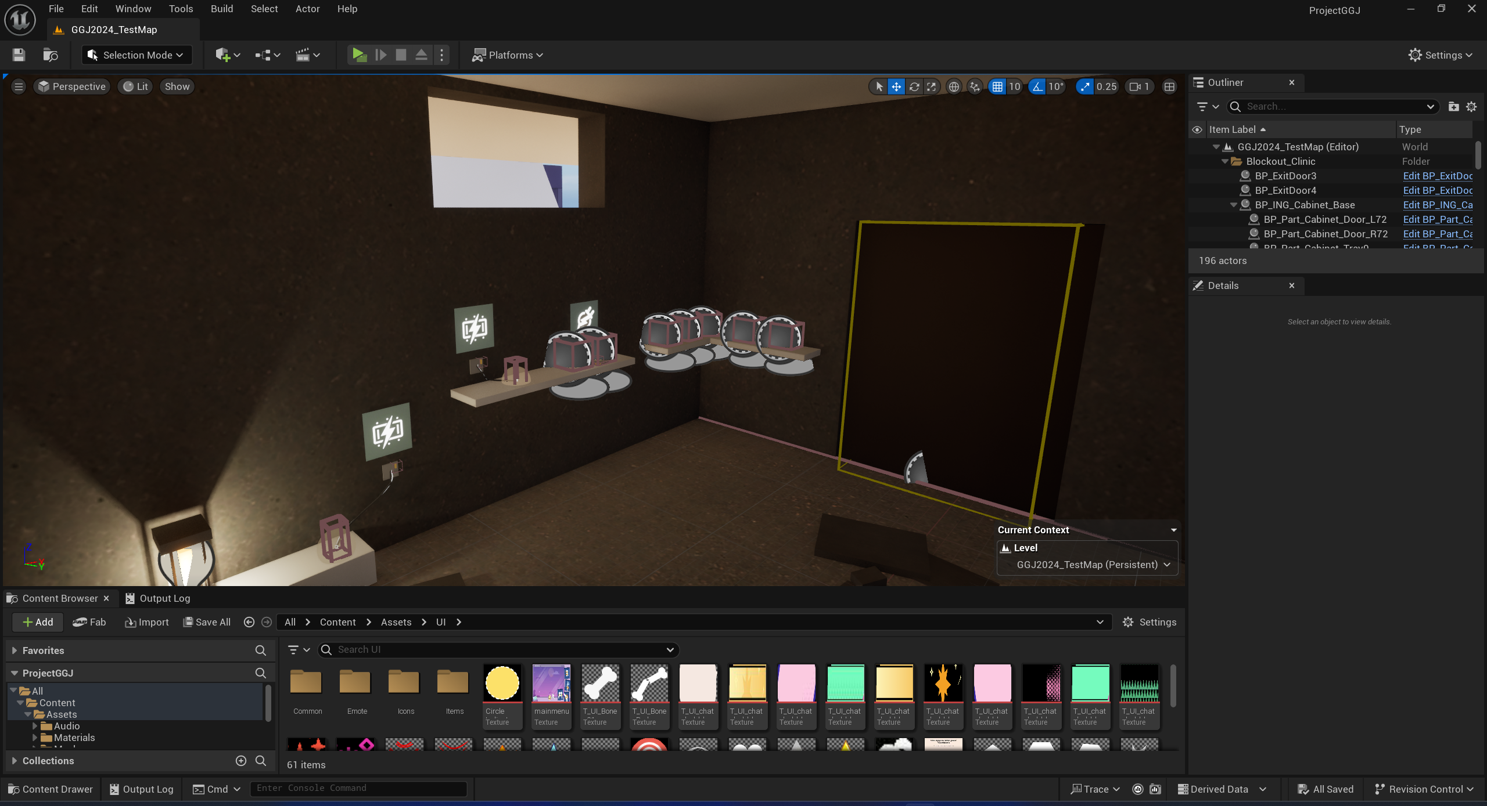
In-engine Proof

